Slide 1

Student group Optimization
Final Exam
MIS 64018
Alex Haffner

Slide 2
Goals of this Project:
Split a group of 12 students into groups of 3
Where each group maximizes the chance of student success
Based on GPA, Age and Previous Courses

Slide 3
Success Factors
Factor Buckets:
GPA = the same as the data used
Age
Student >= 23 - 3 points
21 >= student > 23 - 2 points
Student < 21 - 1 point
Prior Courses:
4 or more courses - 3 points
1-3 courses - 2 points
0 courses - 1 point
GPA
Age
Prior Courses

Slide 4
Student Data
Actual Data
Bucketed Data
Students | GPA | Age | Prior Courses
1 | 4 | 25 | 5
2 | 3.5 | 24 | 3
3 | 3.5 | 24 | 6
4 | 3.5 | 20 | 5
5 | 3 | 24 | 4
6 | 1 | 24 | 0
7 | 2.5 | 21 | 2
8 | 1 | 20 | 3
9 | 3 | 24 | 0
10 | 2 | 23 | 7
11 | 2 | 22 | 2
12 | 1 | 20 | 0
Students | GPA | Age | Prior Courses | Total
1 | 4 | 3 | 3 | 10
2 | 3.5 | 3 | 2 | 8.5
3 | 3.5 | 3 | 3 | 9.5
4 | 3.5 | 1 | 3 | 7.5
5 | 3 | 3 | 3 | 9
6 | 1 | 3 | 1 | 5
7 | 2.5 | 2 | 2 | 6.5
8 | 1 | 1 | 2 | 4
9 | 3 | 3 | 1 | 7
10 | 2 | 3 | 2 | 8
11 | 2 | 2 | 2 | 6
12 | 1 | 1 | 1 | 3
Totals= | 30 | 28 | 26 | 84
Average | 2.5 | 2.33333333 | 2.166666667

Slide 5
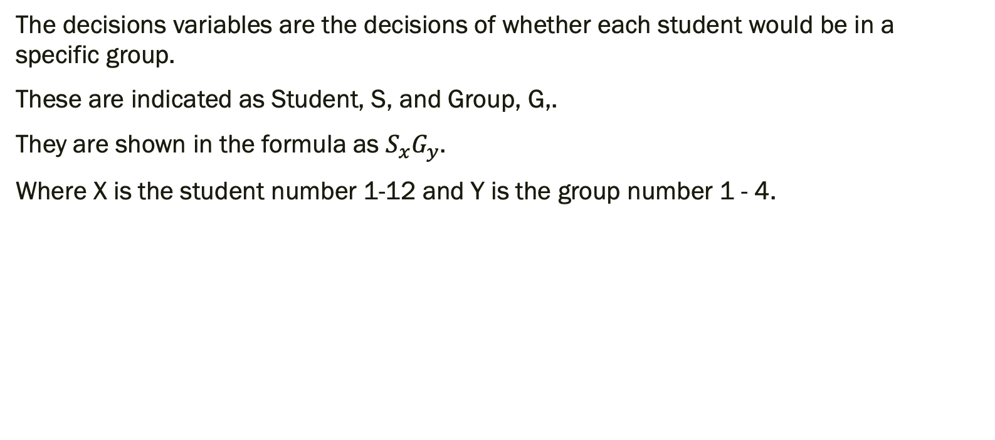
Decision Variables
The decisions variables are the decisions of whether each student would be in a specific group.
These are indicated as Student, S, and Group, G,.
They are shown in the formula as $S_{x}G_{y}$.
Where X is the student number 1-12 and Y is the group number 1 - 4.

Slide 6
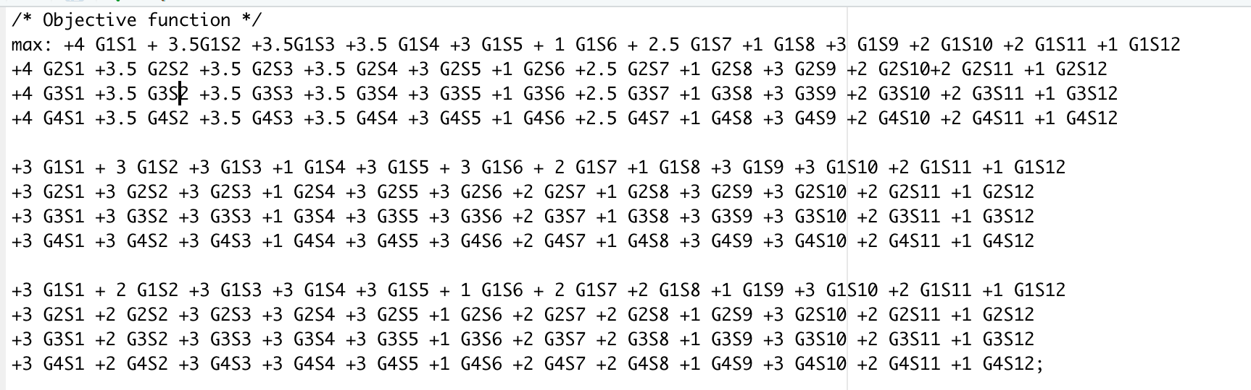
Objective Function
The objective function is to maximize the chance of student success. This is done for each of my success factors.

Slide 7
Constraints
6 sets of constraints:
group size
number of groups a student can be in
GPA
age
prior courses
integer/nonzero constraint

Slide 8
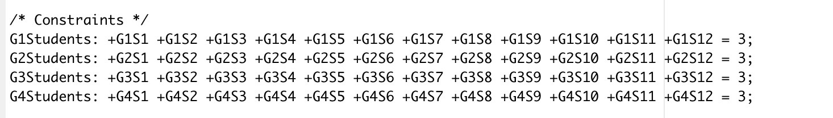
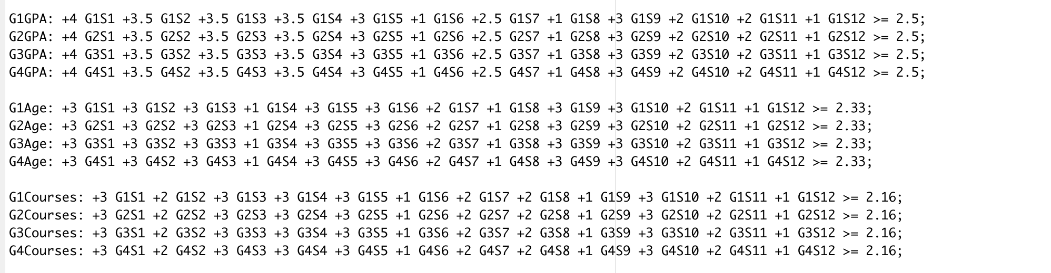
Constraints
The constraints for group size, GPA, age and prior courses.
Notes:
In this slide you see the constraints for group size, GPA, Age and prior courses. Each possible group has a line of constraints. The first picture constrains the groups to 3 students.
The second pictures shows the constraints for GPA, Age and Prior Courses. All these constraints set so they require the groups to be above the average that is shown in student data.

Slide 9
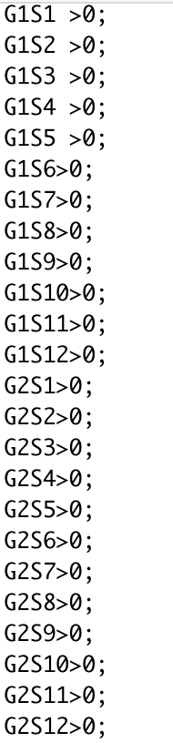
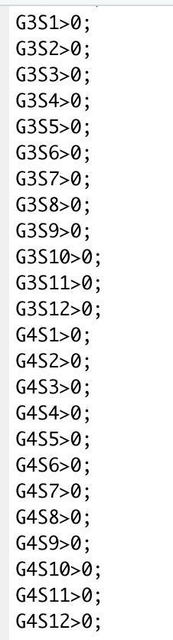
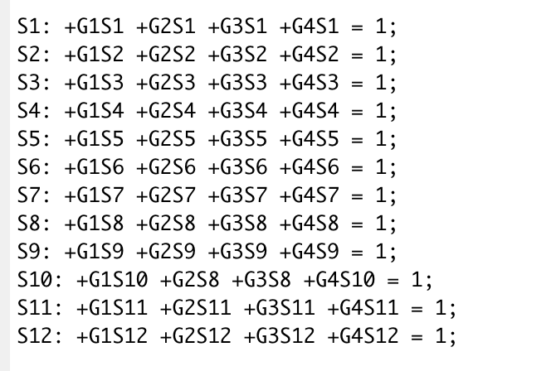
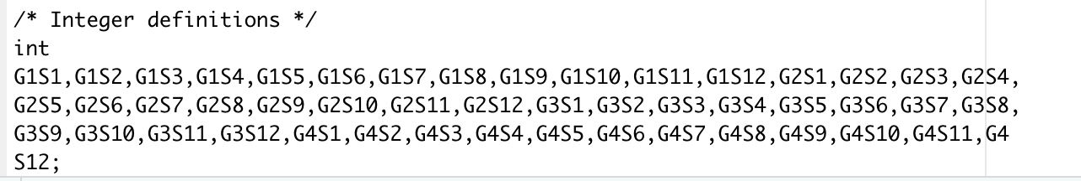
Constraints
Non-zero constraint:
The constraints for number of students per group and integers.
Student Group Number Constraints
Integer constraint:
Notes:
These two sets of constraints are set by each student rather than per group. The first allows students to only be in one group. While the second picture sets each possible outcome as an integer. The third and 4th pictures are the non zero constraints.

Slide 10
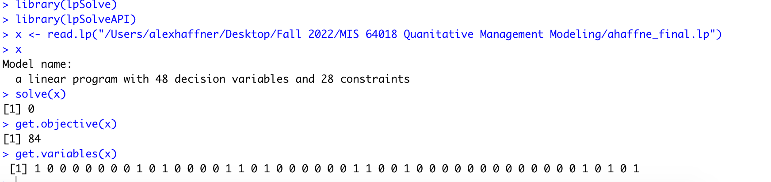
Code
Using lp solve method
solve(x) – shows it was successful
get.objective(x)- shows the total points of all three criteria
get.variables(x) – corresponds to our decision variables and is our final answer
Notes:
Using theLP solve method with an lp file. I was able to come up with a results. The solve(x) function shows that my calculation was successful. The get.objective function shows the total points of all of my criteria. The get.variables is the final answer that I will put in table form in the next slide.

Slide 11
Groups
Groups | Student 1 | Student 2 | Student 3
Group 1 | 1 | 2 | 3
Group 2 | 5 | 7 | 11
Group 3 | 4 | 6 | 9
Group 4 | 8 | 10 | 12
Notes:
The final group selections were:

Slide 12

Conclusion
4 groups of 3 students
each group maximizes the students chance to be successful
github: https://github.com/ahaffne2/MIS-64018_ahaffne2.git
Notes:
Using lpsolve, I was successfully able to divide 12 students into 3 groups that will maximize each groups chance for succuess. Thank you.

